Slide 1
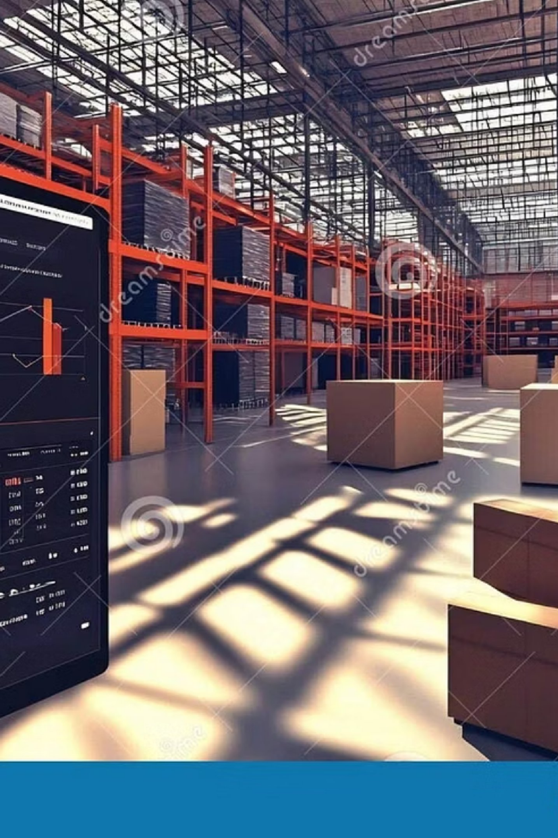

Inventory Management System
A practical guide to tracking, managing, and controlling stock levels
— built for businesses that want to reduce losses, eliminate guesswork, and operate more efficiently.

Slide 2

The Problem with Manual Inventory
Every business that sells products faces the same challenge: keeping accurate records of what's in stock, what's been sold, and what needs reordering. Manual tracking leads to costly mistakes.
❌ Errors & Missing Records
❌ Overstocking or Shortages
Without real-time visibility, businesses either tie up cash in excess stock or disappoint customers with empty shelves.
Human entry mistakes cause discrepancies that snowball into bigger problems over time.
❌ Wasted Time
Manual counts, spreadsheets, and paper logs drain hours that could be spent growing the business.

Slide 3
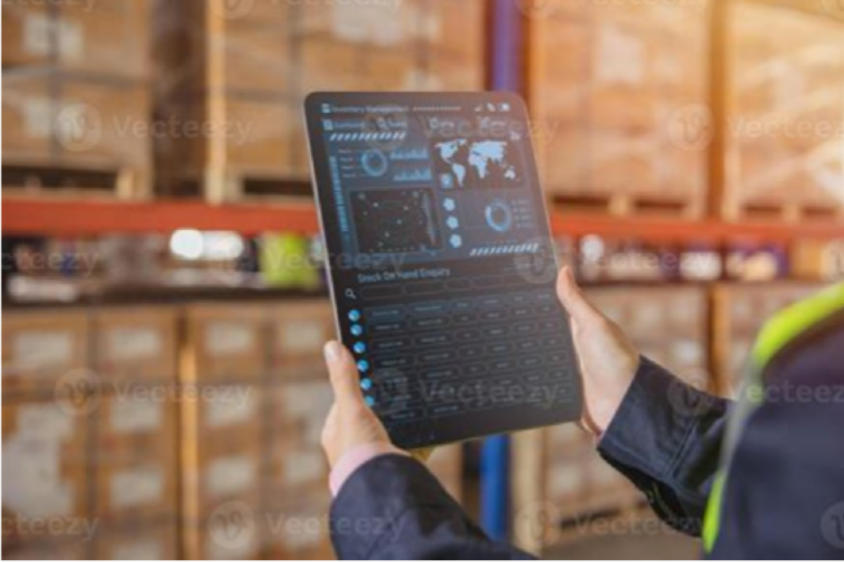
What Is an Inventory Management System?
An Inventory Management System (IMS) is a software application designed to automate the tracking and control of stock levels, orders, sales, and deliveries.
Stores product details in a structured, searchable format
Provides instant access to current stock information
Automates routine tasks like alerts and report generation
Helps businesses make faster, data-driven decisions

Slide 4




Core Objectives
Accurate Stock Records
Maintain up-to-date product data at all times — no more guessing what's on the shelf.
Reduce Manual Errors
Automate data entry and validation to eliminate costly mistakes from human oversight.
Generate Reports Easily
Produce stock summaries and business insights with a single command — no manual compilation needed.
Improve Efficiency
Save time and effort by simplifying inventory handling from product entry to delivery tracking.

Slide 5

System Requirements
💻 Software
🖥 Hardware
OS | Windows / Linux |  | Device | Computer or Laptop
Language | C++ / Java / Python |  | RAM | Minimum 4GB
Database | MySQL (optional) |  | Storage | 500GB HDD or above
IDE | Code::Blocks / VS Code |  | Input | Keyboard & Mouse
Tools | Compiler + Text Editor |  | Power | Stable supply required
An internet connection is optional — primarily useful for applying software updates or enabling cloud-based database access.

Slide 6
Key Features
Product Management
Add new products, update existing details, and delete discontinued items — all from a single interface.
Stock Visibility
View and search current stock levels instantly. See exactly what's available, where, and in what quantity.
Low Stock Alerts
The system automatically flags products falling below a defined threshold — so you never run out unexpectedly.
Report Generation
Generate detailed inventory reports for analysis, audits, and smarter business planning — on demand.

Slide 7
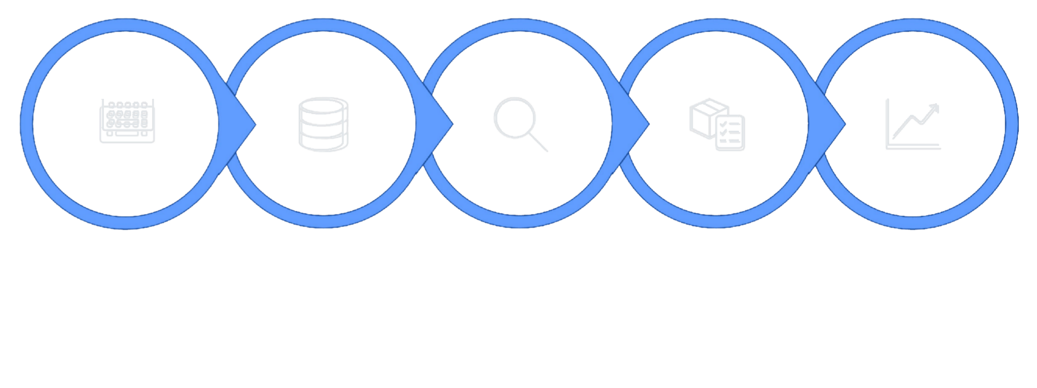
How It Works
Store Records
Update / Search
Generate Reports
Enter Data
Check Stock
The system follows a structured, linear workflow — from data entry to report output. Every action triggers an immediate update to the central data store, ensuring records stay accurate in real time without manual intervention.

Slide 8
Technology & Applications
Technology Stack
Where It's Used
Retail stores & supermarkets
Warehouses & manufacturing facilities
E-commerce businesses
Medical stores & pharmacies
Libraries
Database integration (MySQL) is optional but recommended for larger datasets. IDE and compiler tools complete the development environment.
C++
Core language with OOP & file handling
Data Structures
Efficient product storage & retrieval

Slide 9

Advantages & Limitations
o Advantages
Saves significant time over manual tracking
Reduces costly data entry errors
Easy to use with minimal training
Improves stock control and planning
Quick access to information anytime
⚠ Limitations
Requires basic technical knowledge to set up
Initial configuration takes time and effort
Performance depends on system hardware
Needs regular maintenance to stay reliable
Data loss risk without proper backup strategy
Always implement a regular backup routine to prevent data loss due to hardware failure or system crashes.

Slide 10

Ready to Take Control of Your Inventory?
An Inventory Management System is a practical, affordable step toward running a more efficient, accurate, and profitable business — whether you're a small shop owner or a developer building your first system.
01 02
Set Up Your Environment
Install the required IDE, compiler, and optionally configure your database.
Define Your Product Structure
Plan what data fields you need — name, quantity, price, category, thresholds.
03
Build, Test & Deploy
Implement core features, test with real data, and start managing inventory digitally.

